Slide 1
c2j

Slide 2
What is a cross compiler?
A cross compiler is a compiler capable of creating executable code for a platform other than the one on which the cross compiler is run.

Slide 3
What is a Language cross compiler?
A language cross compiler is a compiler capable of creating target code for a language other than the one with which the source code is written.

Slide 4
c2j

Slide 5
C to java Cross Compiler

Slide 6
Bivas Das
Amritam Sarcar
Ishan Chakraborty
Aparna Chakraborty

Slide 7
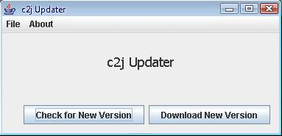
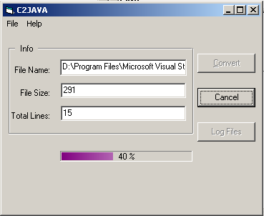
CROSS COMPILER OVERVIEW

Slide 8
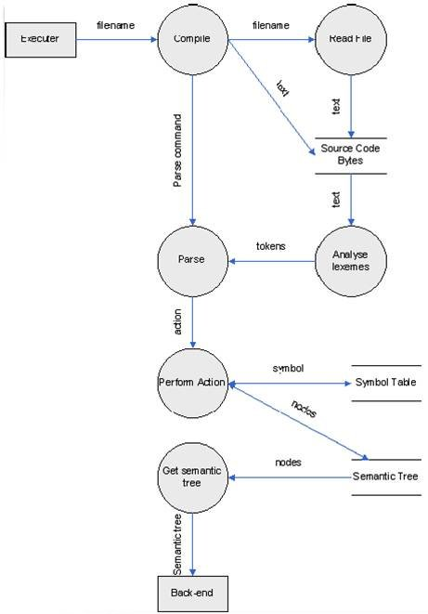
DATA FLOW DIAGRAM

Slide 9
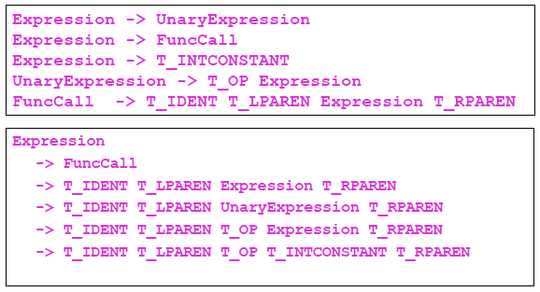
The Parser
sqrt(-1)

Slide 10
M/c Independent Source Code
...
#ifdef __TURBOC__
#endif
...
strcmpi(st1,st2);
strncmpi(st1,st2,n);
stricmp(st1,st2);

Slide 11
On The Run

Slide 12
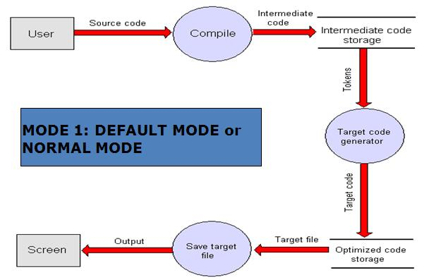
GENERAL PROCESS DIAGRAM

Slide 13
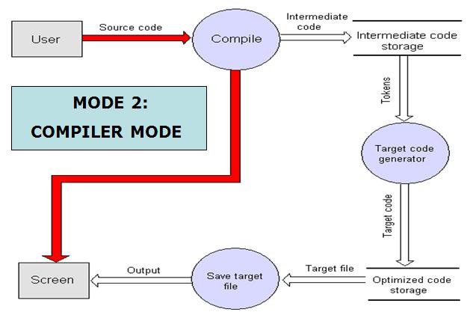
Compiler Mode

Slide 14
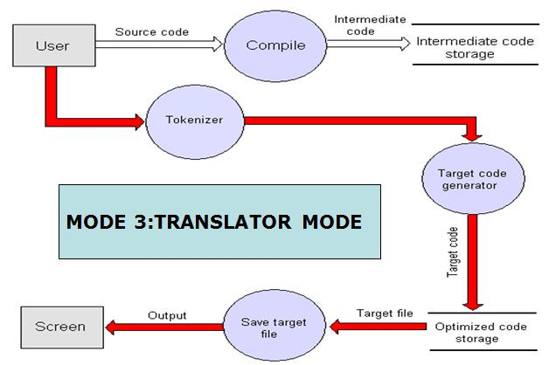
Translator Mode

Slide 15
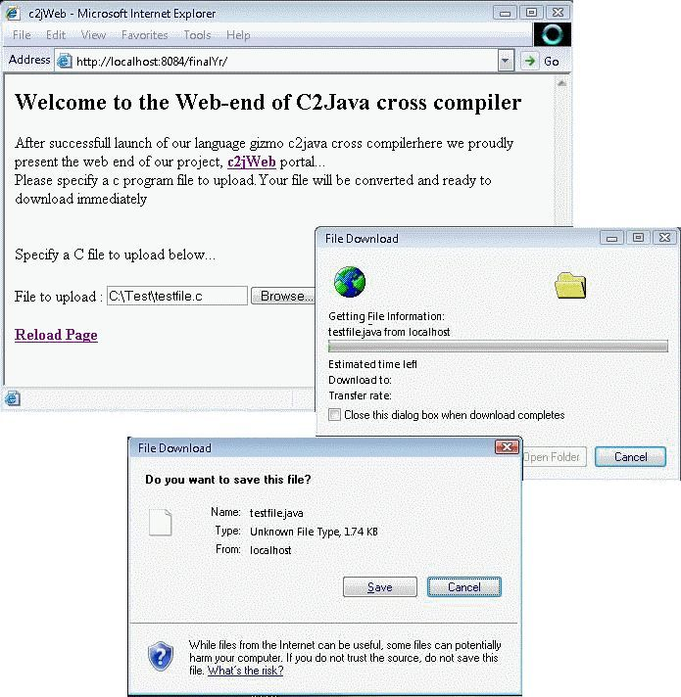
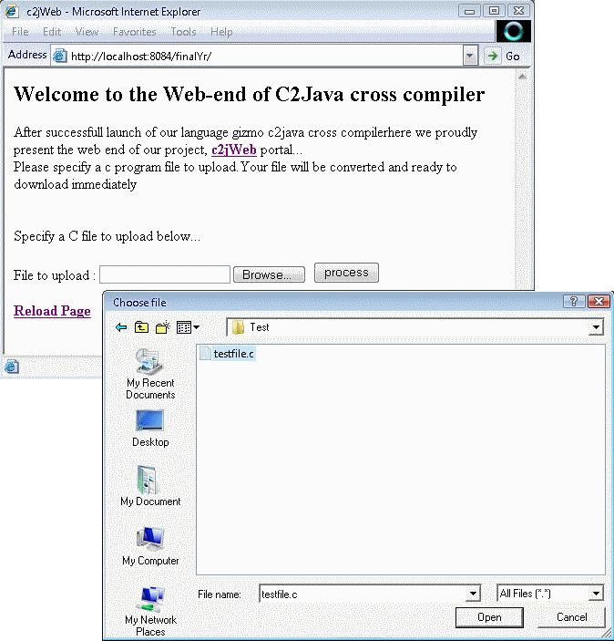
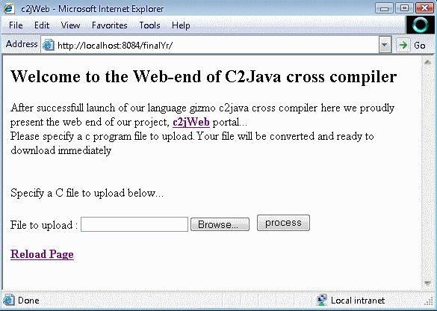
The universal front end

Slide 16
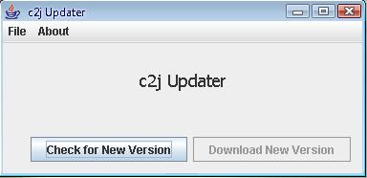
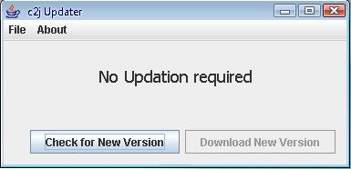
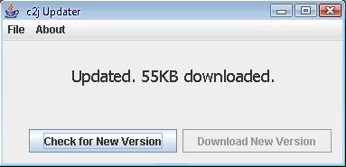
The Updater

Slide 17
On The Run

Slide 18
The Windows front end
Contains the file size, no. of lines and the file name that is being compiled.
This button remains disabled if there is no error in the source file
The progress bar depicting the cross compilation process.

Slide 19
Windows…
The log file button is enabled due to error in source file
The different errors are being displayed that have been found in the source file, Bivas5.C

Slide 20
Windows…
The equivalent Java code, staring with class A
Optimized code, the target code has no blank spaces

Slide 21
Connecting win32 & win16
( interconnection between VB & DOS )
The argument File Name given here
Calling the cross-compiler executable from here
Hiding the execution from the viewer

Slide 22
On The Run

Slide 23
Converter Diagram

Slide 24
Converter Algorithm
1. FOR EVERY TOKEN DO
2. CHECK FOR PROPER MAPPING, if possible
3. IF MAP PRESENT CONVERT (and do processing)
4. CHECK FOR VALIDITY OF TOKEN
5. IF VALID, WRITE THE TOKEN
6. END

Slide 25
Converter Algorithm
1. FOR EVERY TOKEN DO
2. CHECK FOR PROPER MAPPING, if possible
3. IF MAP PRESENT CONVERT (and do processing)
4. CHECK FOR VALIDITY OF TOKEN
5. IF VALID, WRITE THE TOKEN
6. END
Mapping
sin(x)

Slide 26
Converter Algorithm
1. FOR EVERY TOKEN DO
2. CHECK FOR PROPER MAPPING, if possible
3. IF MAP PRESENT CONVERT (and do processing). GOTO STEP 1
4. CHECK FOR VALIDITY OF TOKEN
5. IF VALID, WRITE THE TOKEN
6. END
Math.sin
Mapping
sin(x)

Slide 27
Converter Algorithm
1. FOR EVERY TOKEN DO
2. CHECK FOR PROPER MAPPING, if possible
3. IF MAP PRESENT CONVERT (and do processing). GOTO STEP 1
4. CHECK FOR VALIDITY OF TOKEN
5. IF VALID, WRITE THE TOKEN
6. END
Math.sin
Mapping
sin(x)

Slide 28
Converter Algorithm
1. FOR EVERY TOKEN DO
2. CHECK FOR PROPER MAPPING, if possible
3. IF MAP PRESENT CONVERT (and do processing). GOTO STEP 1
4. CHECK FOR VALIDITY OF TOKEN
5. IF VALID, WRITE THE TOKEN
6. END
Math.sin
Mapping
sin(x)

Slide 29
Converter Algorithm
1. FOR EVERY TOKEN DO
2. CHECK FOR PROPER MAPPING, if possible
3. IF MAP PRESENT CONVERT (and do processing). GOTO STEP 1
4. CHECK FOR VALIDITY OF TOKEN
5. IF VALID, WRITE THE TOKEN
6. END
Math.sin
Mapping
sin(x)
Validity?

Slide 30
Converter Algorithm
1. FOR EVERY TOKEN DO
2. CHECK FOR PROPER MAPPING, if possible
3. IF MAP PRESENT CONVERT (and do processing). GOTO STEP 1
4. CHECK FOR VALIDITY OF TOKEN
5. IF VALID, WRITE THE TOKEN
6. END
Math.sin(
Mapping
sin(x)
Validity?

Slide 31
Simple to Complex
strstr(s,s2) public static String strstr(String s, String s2)
{
int i = s.indexOf(s2);
if(i == -1)
return null;
else
return s.substring(i);
}
strlen(s1) s1.length()

Slide 32
On The Run

Slide 33
In the End
Special thanks to…
PROF. MADHULINA SARKAR
PROF. ASIT KUMAR SHIROMANI
PROF. AMIYA HALDAR
DR. SUBARNA BHATTACHARYA

