Slide 1
RAC Support for JML on Eclipse Platform
Amritam Sarcar
(Advisor: Yoonsik Cheon)
Support by NSF under grant CNS-0707874

Slide 2
Introduction
Java Modeling Language (JML)
Formal behavioral interface specification language for Java
Documentation of Java modules (classes and interfaces)
Spectrum of tool support
From runtime assertion checking (RAC) to theorem proving
RAC and ESC/Java most widely used

Slide 3
Problems with JML tools
Lack of robustness
Lack of extensibility
Not designed for it, e.g., code base for developing other tools
Maintenance overheads
Built upon a not-well-supported open-source Java compiler
No support for Java 1.5 features such as generics
Future changes in Java

Slide 4
Project Goal and Approach
Goal: To redevelop the JML compiler (jmlc)
Java 1.5 features such as generics
Future Java language changes, e.g., Java 1.8 and beyond
Code base for other JML tools
Approach
Develop a new compiler based on the Eclipse Java compiler
Design it with extensibility in mind

Slide 5
Accomplishments
Investigated several alternative architectures
Tool architectures: double-Round, incremental, bytecode weaving, and AspectJ-based
Bytecode architecture: inline, wrapper, and semi-wrapper
Proposed “incremental architecture” through analysis, comparison, and feasibility study (e.g., prototype)

Slide 6
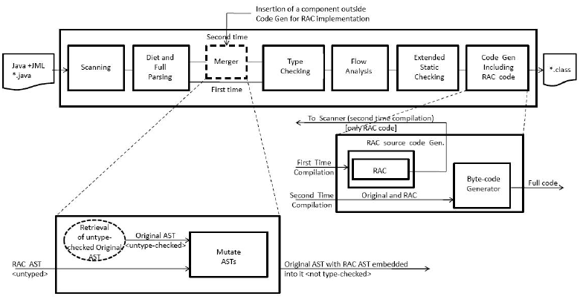
Incremental Architecture

Slide 7
Current and Future Work
Baseline architectural code for the incremental architecture
Full-blown development in collaboration with other JML developers at Kansas State and Concordia

